Slide 1










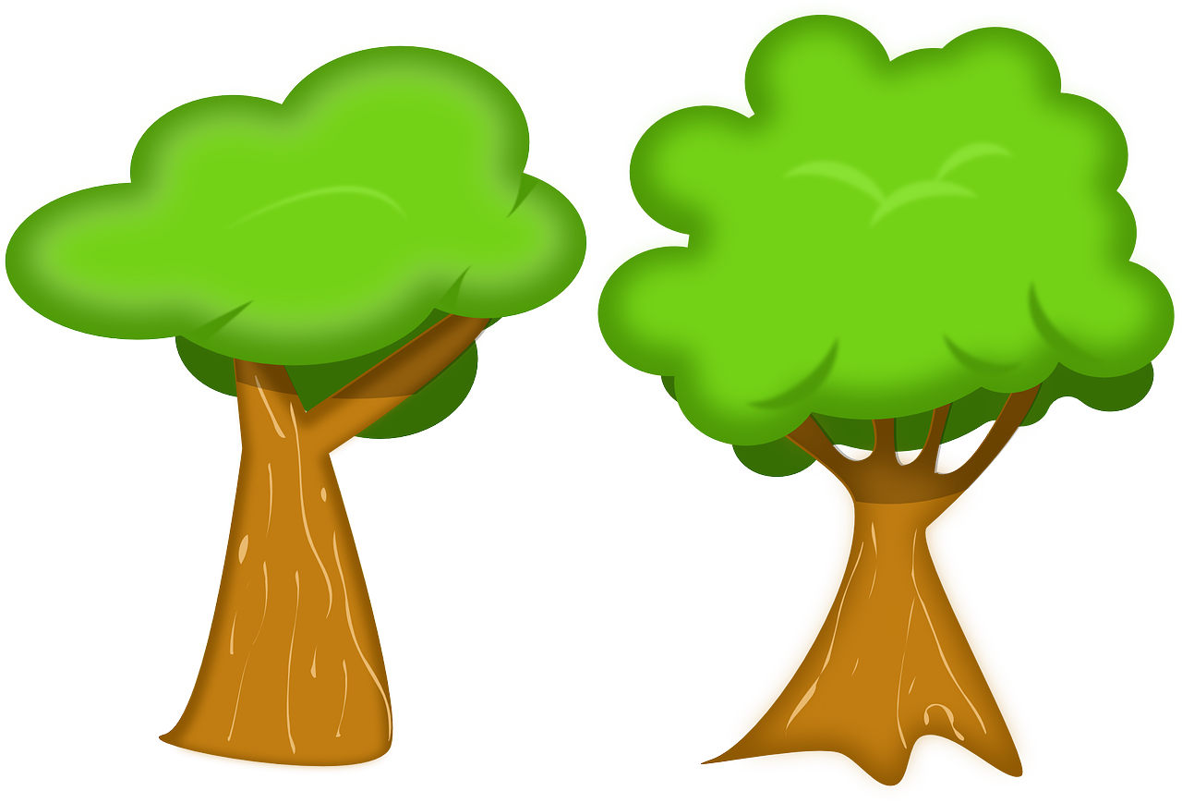

Mission Assignment: Investigate the Carbon Cycle
MA Code: N22.KS3.08
Fill in information about what step of the carbon cycle occurs at each of the following locations. What happens next?
1._Atmosphere:____________________________________________________________________________________________________________________________________________________________2._Soil:_________________________________________________________________________________________________________________________________________________________________
3._Ocean:_______________________________________________________________________________________________________________________________________________________________
4._Plant:________________________________________________________________________________________________________________________________________________________________
5._Rabbit:_______________________________________________________________________________________________________________________________________________________________
6._Fox:_________________________________________________________________________________________________________________________________________________________________
7._Fossil_fuel:_____________________________________________________________________________________________________________________________________________________________
Developing Experts Copyright 2022 All Right Reserved

Slide 2
Mission Assignment: Investigate the Carbon Cycle
MA Code: N22.KS3.08
Label the following diagram of the carbon cycle
Word bank:
CO² in atmosphere Consumers Producers Photosynthesis Decomposers
Developing Experts Copyright 2022 All Right Reserved

Slide 3
Mission Assignment: Investigate the Carbon Cycle
MA Code: N22.KS3.08
What are the carbon sinks?
____________________________________________________________________________________________________________________________________________________________________________________________________________________________________________________
Why are carbon sinks important?
______________________________________________________________________________________________________________________________________________________________________________________________________________________________________________________________________________________________________________________________________________________________________________
Why are the levels of carbon dioxide increasing? How can we reduce them?
_______________________________________________________________________________________________________________________________________________________________________________________________________________________________________________________________________________________________________________________________________________________________________________________________________________________________________________________________________________________________________________________________________________________________________________________________________________________________________________________________________________________________
Developing Experts Copyright 2022 All Right Reserved

